Slide 1
Elixir Cloud Applications: Fast, Strong, Concurrent and Scalable

Slide 2

Daniel Augusto Krug
linkedIn: https://www.linkedin.com/in/daniel-krug-427646b9
github: https://github.com/DaanKrug
site: skallerten.com.br

Slide 3
Elixir Motivation:
I’m working whit PHP Laravel + Angular project whit some questions in mind:
- Scalability
- Response Time
- Resources Consumption

Slide 4
I need this!
The Elixir of Life por Fabio Akita - DevInSantos 2015
https://www.youtube.com/watch?v=8Ng6TfAj7Sk&t=30s

Slide 5
Developer Enviroment:
https://github.com/DaanKrug/Ubuntu-18.04-developer-fast-setup

Slide 6
Creating a new project
1 - cd /var/www/html
2 - mkdir elixir_cipher
3 - sudo chmod 777 elixir_cipher
4 - Eclipse IDE >> File >> Open Projects from filesystem
>> Import source: [/var/www/html/elixir_cipher] >> finish
5 - cd elixir_cipher
6 - sudo mix new ex_cipher

Slide 7
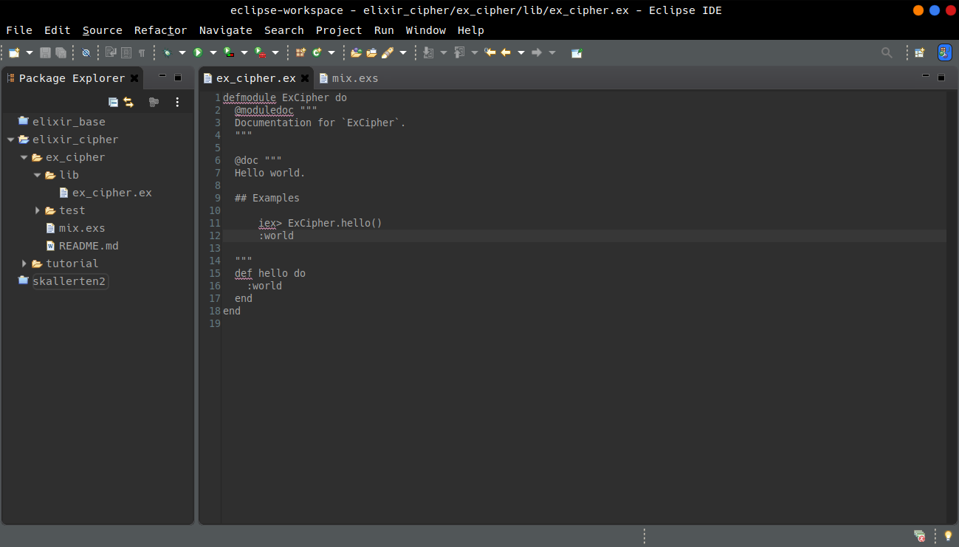

Slide 8
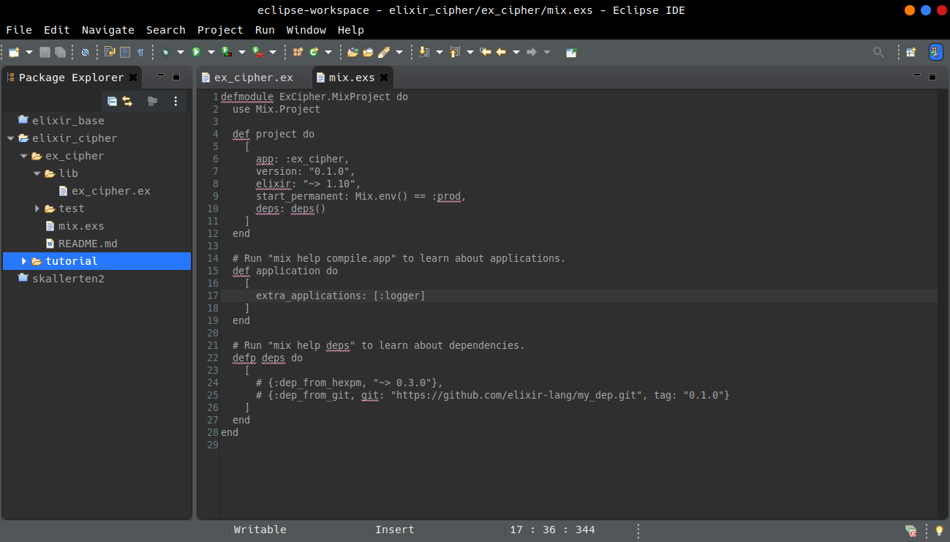

Slide 9
Configuring new Ecto DB handler
7 - cd ex_cipher/lib
mkdir app_configuration | mkdir enviroment
cd app_configuration | mkdir ecto | cd ecto | mkdir app
File >> New >> File [app.dao.ex]
File >> New >> File [app.repo.ex]
cd ../../enviroment
File >> New >> File [enviroment.decisor.ex]
File >> New >> File [enviroment.env.ex]
File >> New >> File [enviroment.reader.ex]

Slide 10
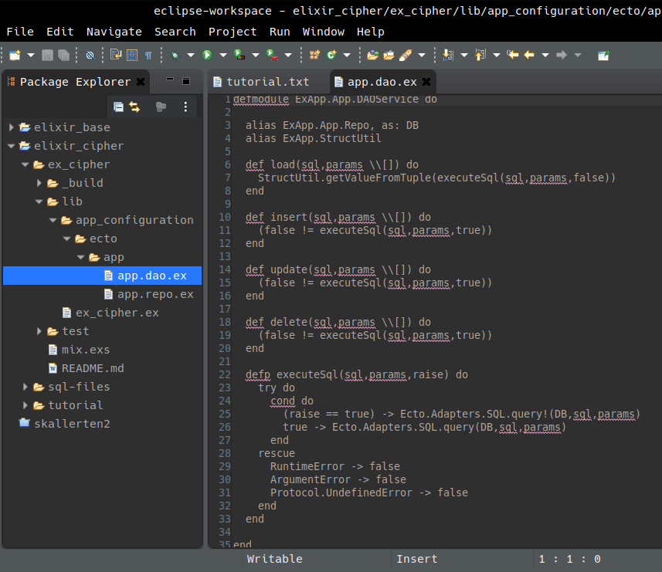

Slide 11
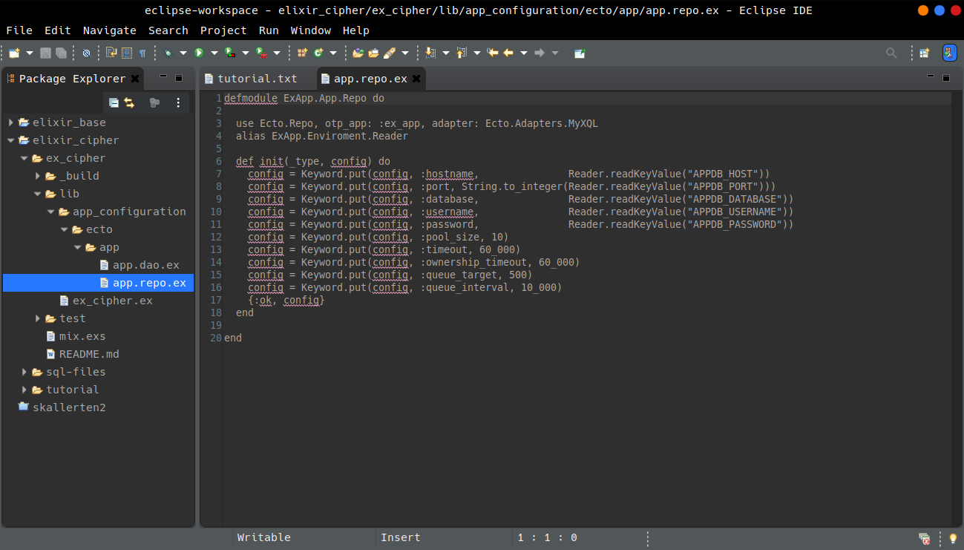

Slide 12
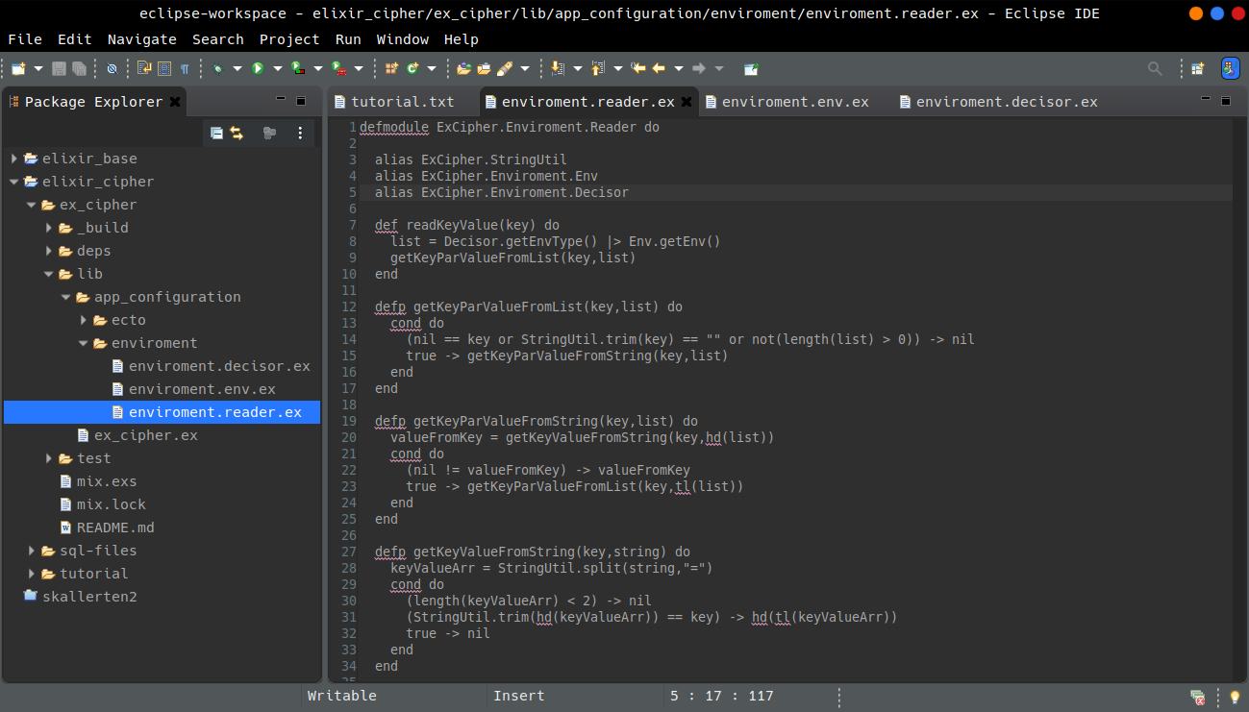

Slide 13
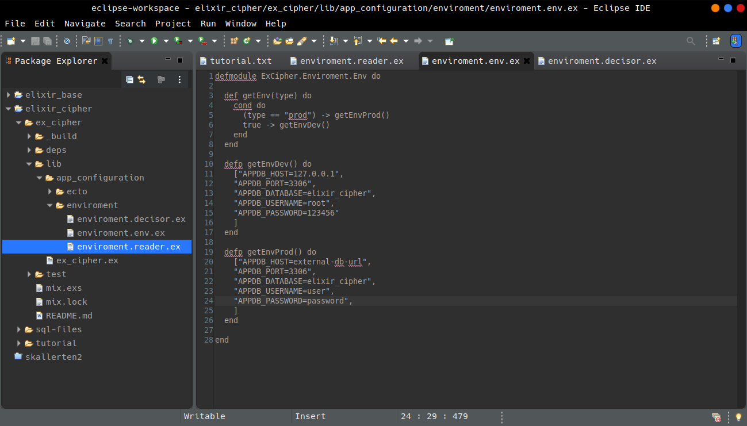

Slide 14
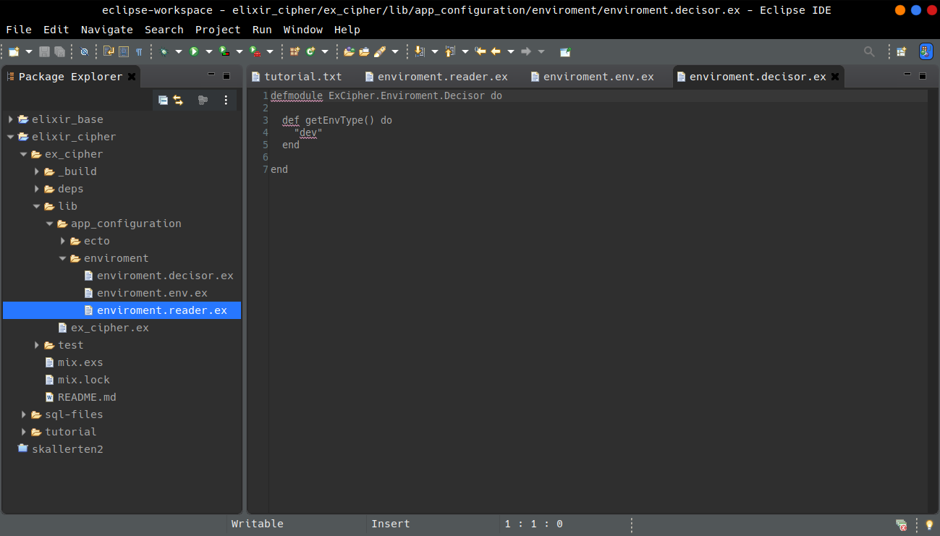

Slide 15
Libraries
8 - Add libs to mix file, and configure external apps

Slide 16
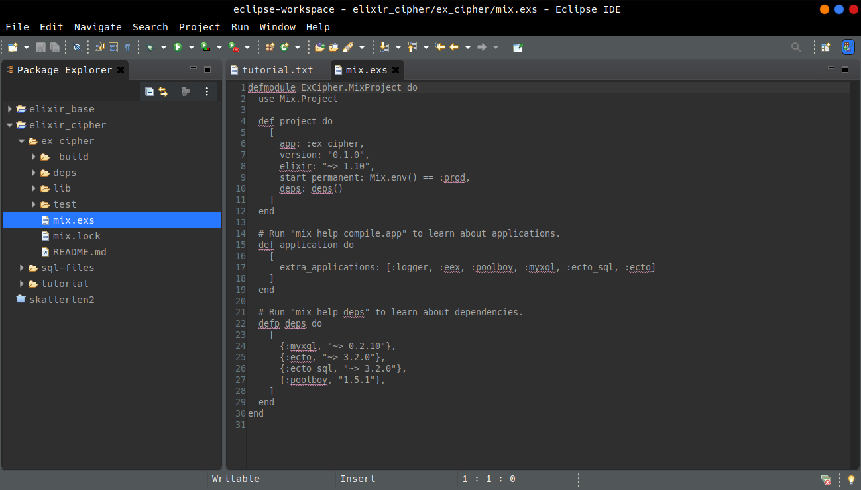

Slide 17
Configuration files
9 - Add config files
cd ex_cipher
mkdir config
File >> New >> File [config.exs]
File >> New >> File [dev.exs]
File >> New >> File [prod.exs]

Slide 18
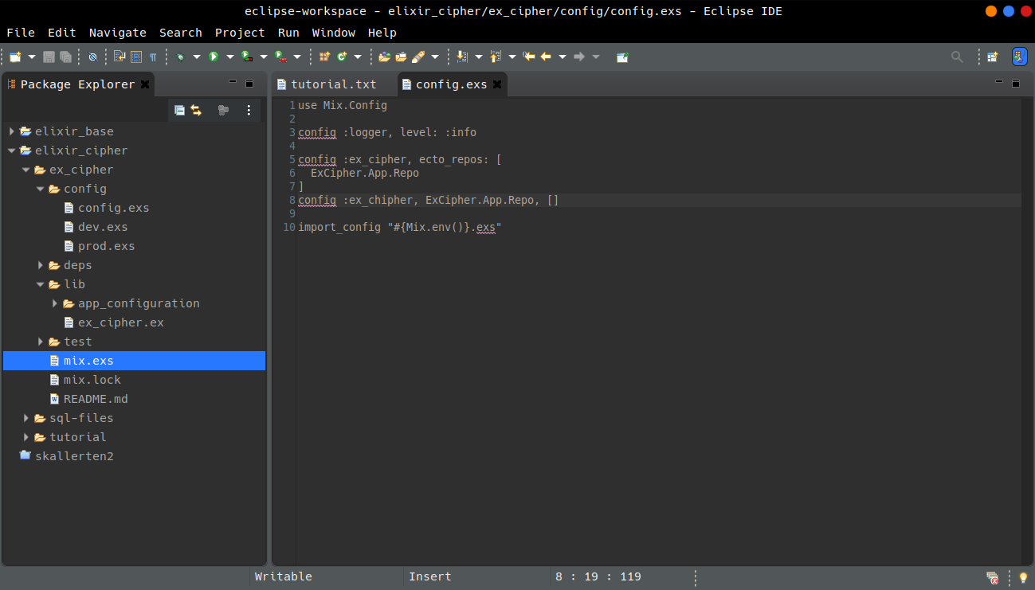

Slide 19
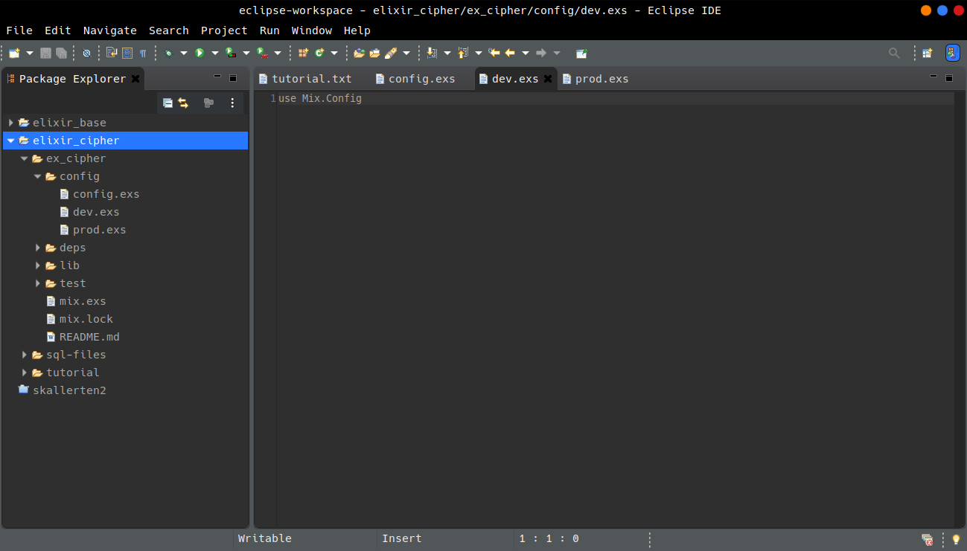

Slide 20
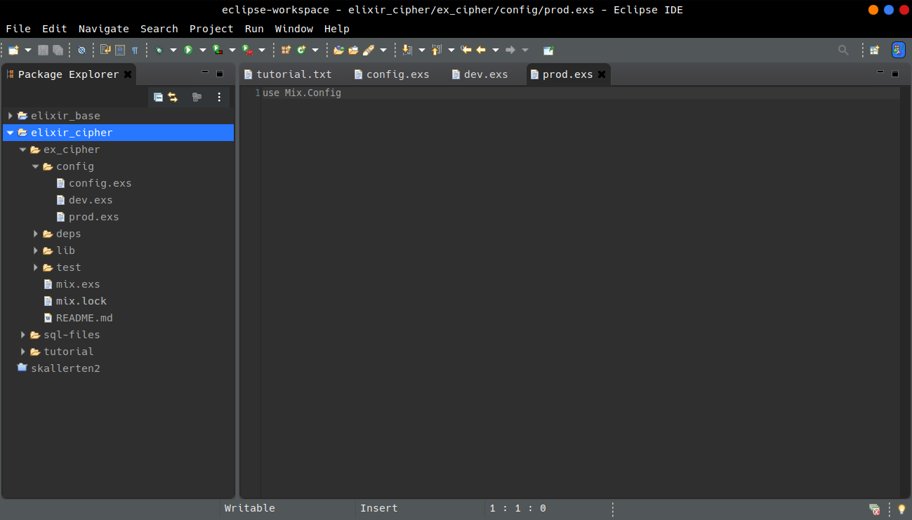

Slide 21
Application Bootstrap
10 - create the "Application"
cd ex_cipher/lib
File >> New >> File [ex_cipher.application.ex]

Slide 22
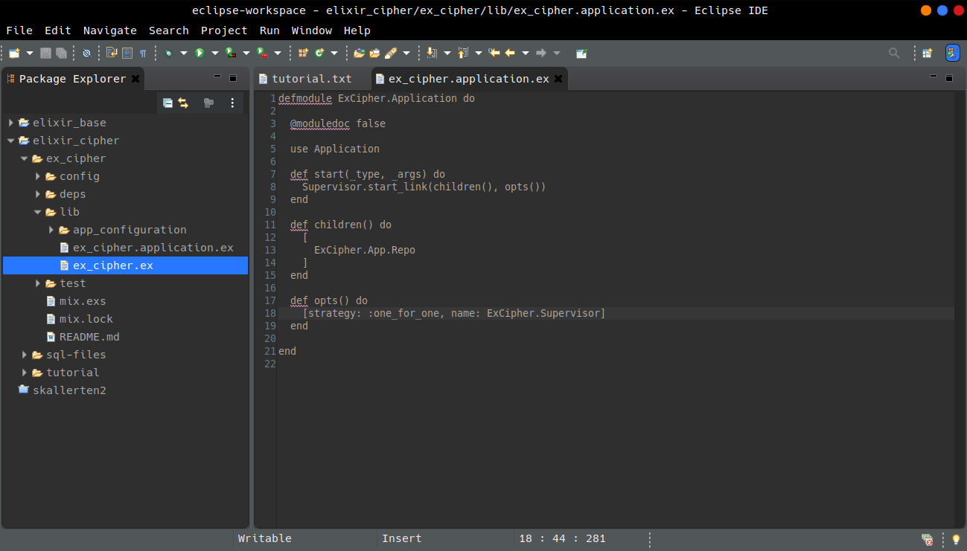

Slide 23
First Compilation
11 - Test if compile:
sudo mix do deps.get, deps.compile, compile

Slide 24
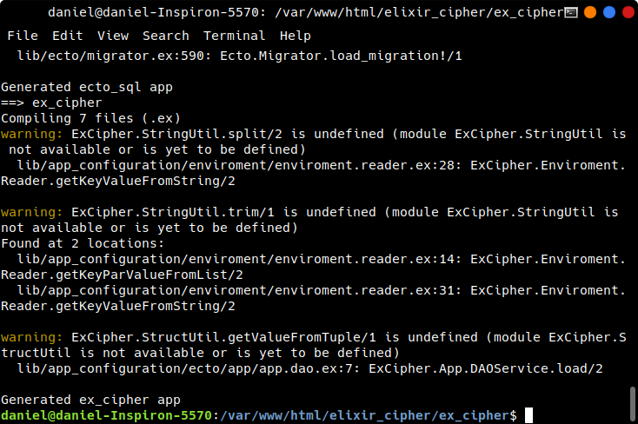

Slide 25
Errors are shown
Need add personal modules created for another project. These are utilitaries make for easy use, of some functions, and to grant these functions always return values (valid or null/empty) never throw exception.
By default Elixir/Erlang always throw exceptions for unexpected values.
In Elixir/Erlang is responsibility of developer handle unexpected values/errors of yourself code. Try Catch exists, but is not better way to make this. And it's very ugly too.

Slide 26
mkdir app_util
cd app_util
File >> New >> File [string.util.ex]
File >> New >> File [struct.util.ex]
sudo mix do deps.get, deps.compile, compile
Now compiles right.

Slide 27
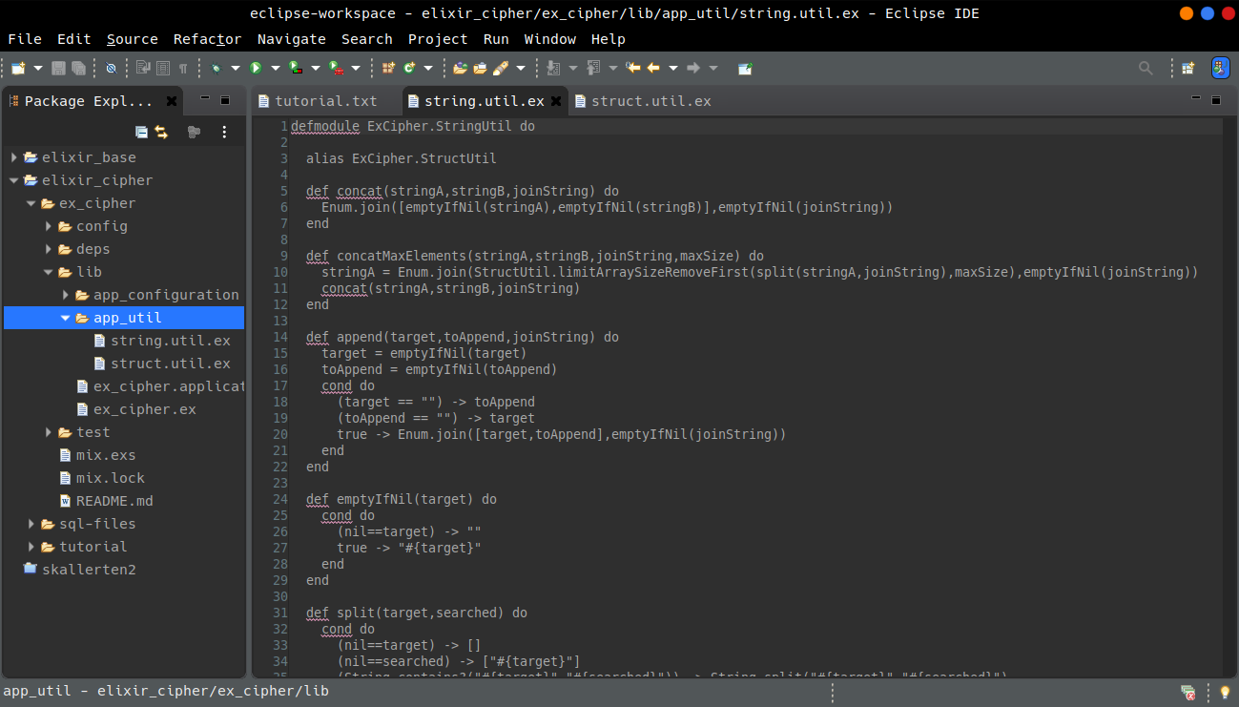

Slide 28
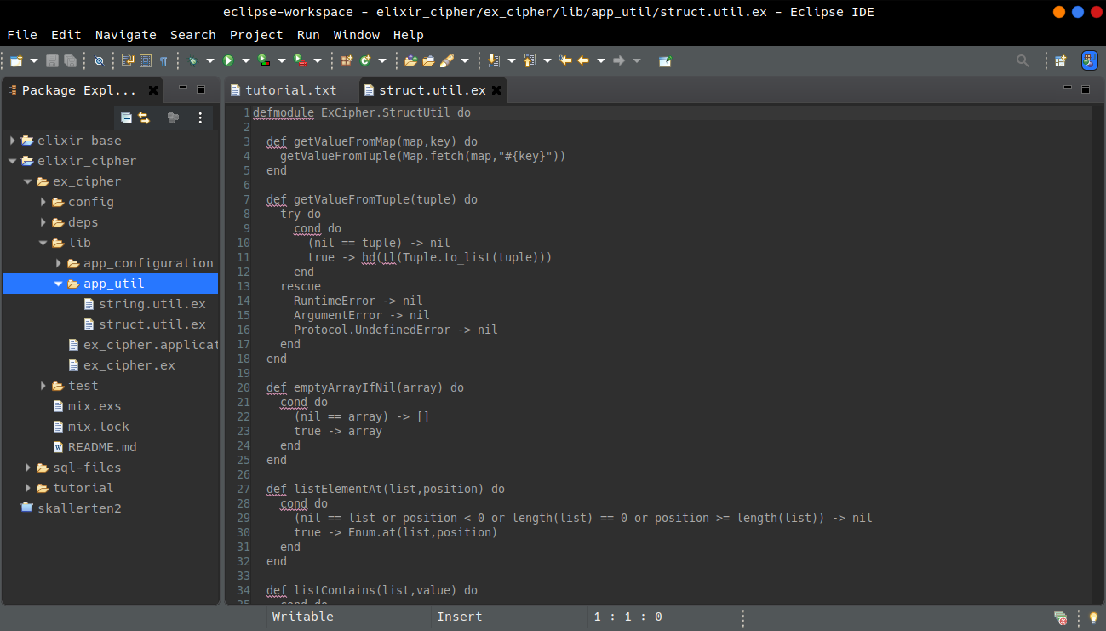

Slide 29
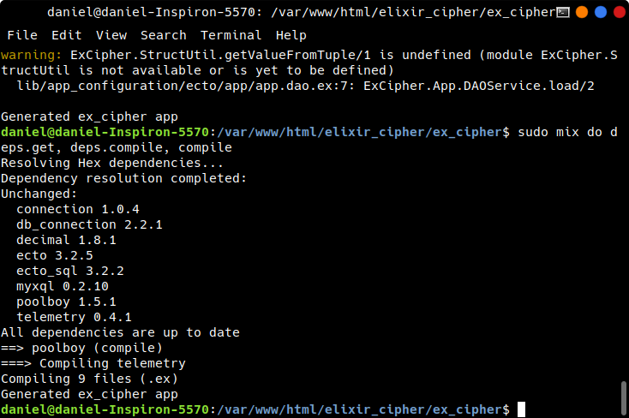

Slide 30
12 - Let's go test
cd ex_cipher
sudo mix run --no-halt
Oh, configuration throwble!

Slide 31
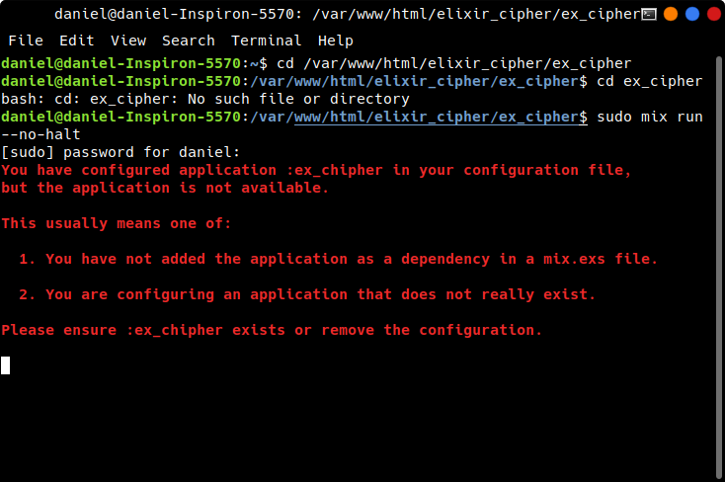

Slide 32
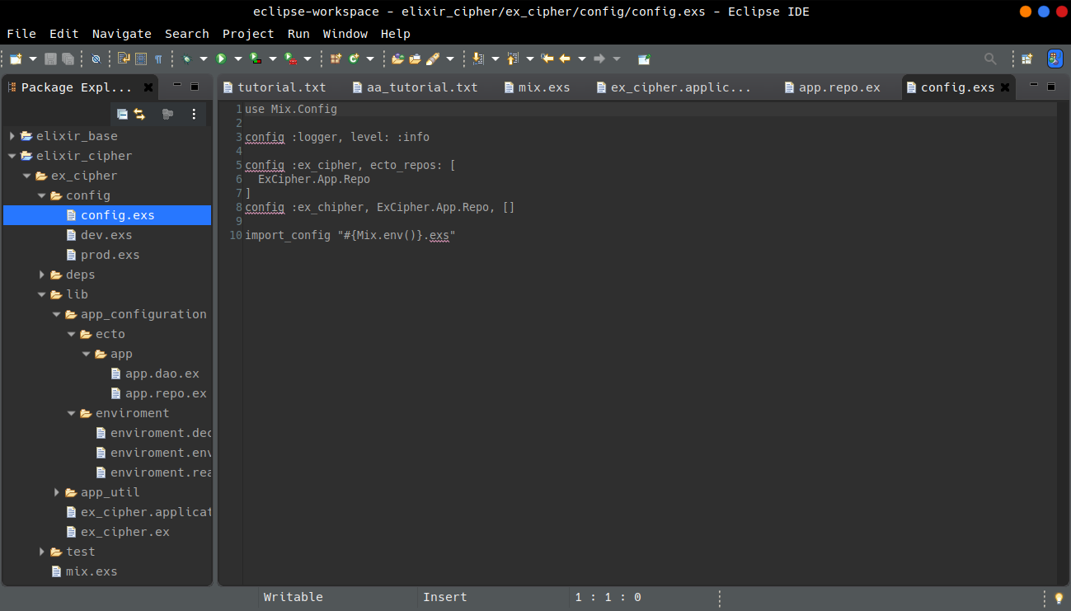

Slide 33
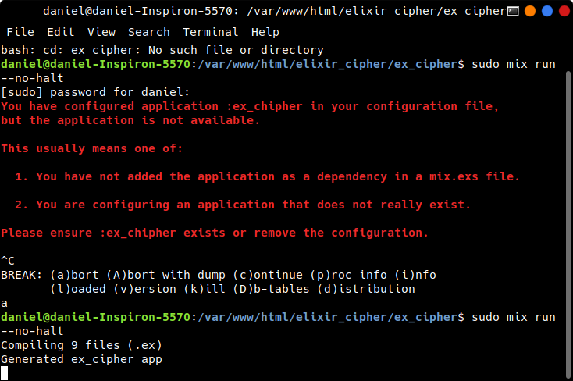

Slide 34
Ok, however this obviously don't show anything in console.
Let's build a functionality to use the DB config to probe that this works.

Slide 35
Concurrency and DB
13 - Making database accessible
cd ex_cipher/lib
mkdir uncipheredmsg
cd uncipheredmsg
File >> New >> File [uncipheredmsg.dto.ex]
File >> New >> File [uncipheredmsg.service.ex]
I already add another utilitary files to folders app_util and app_handler.

Slide 36
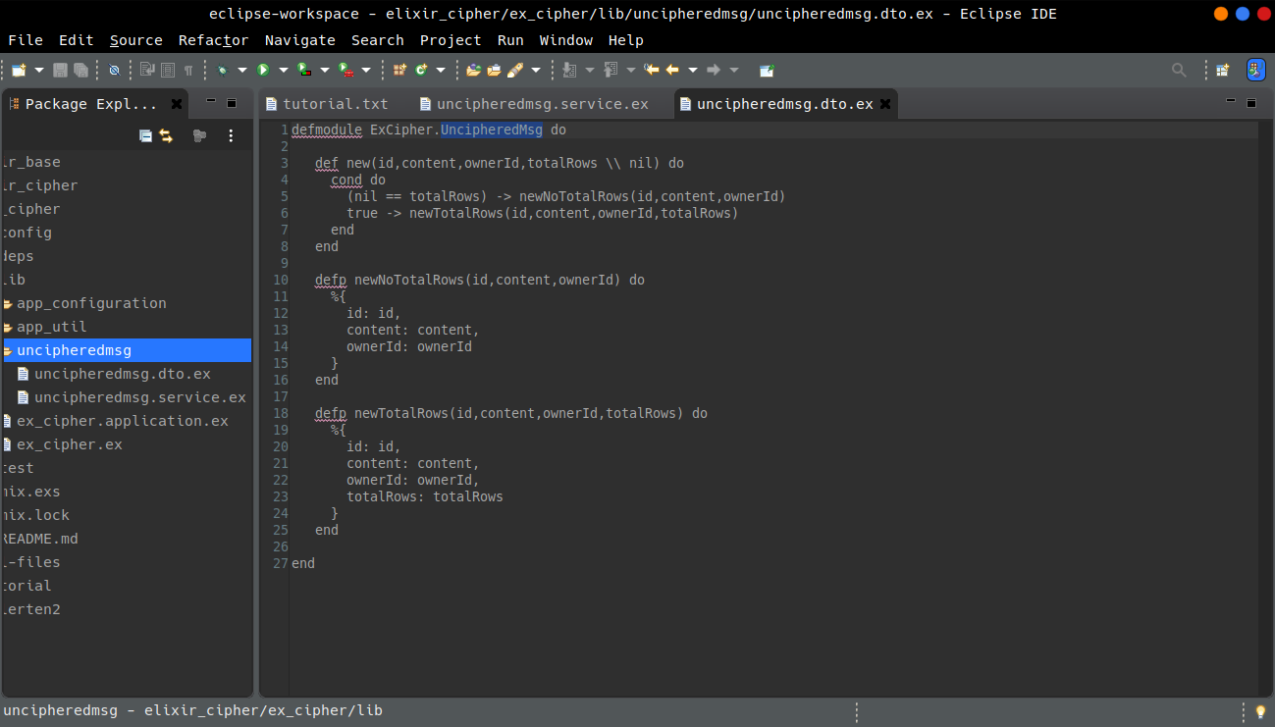

Slide 37
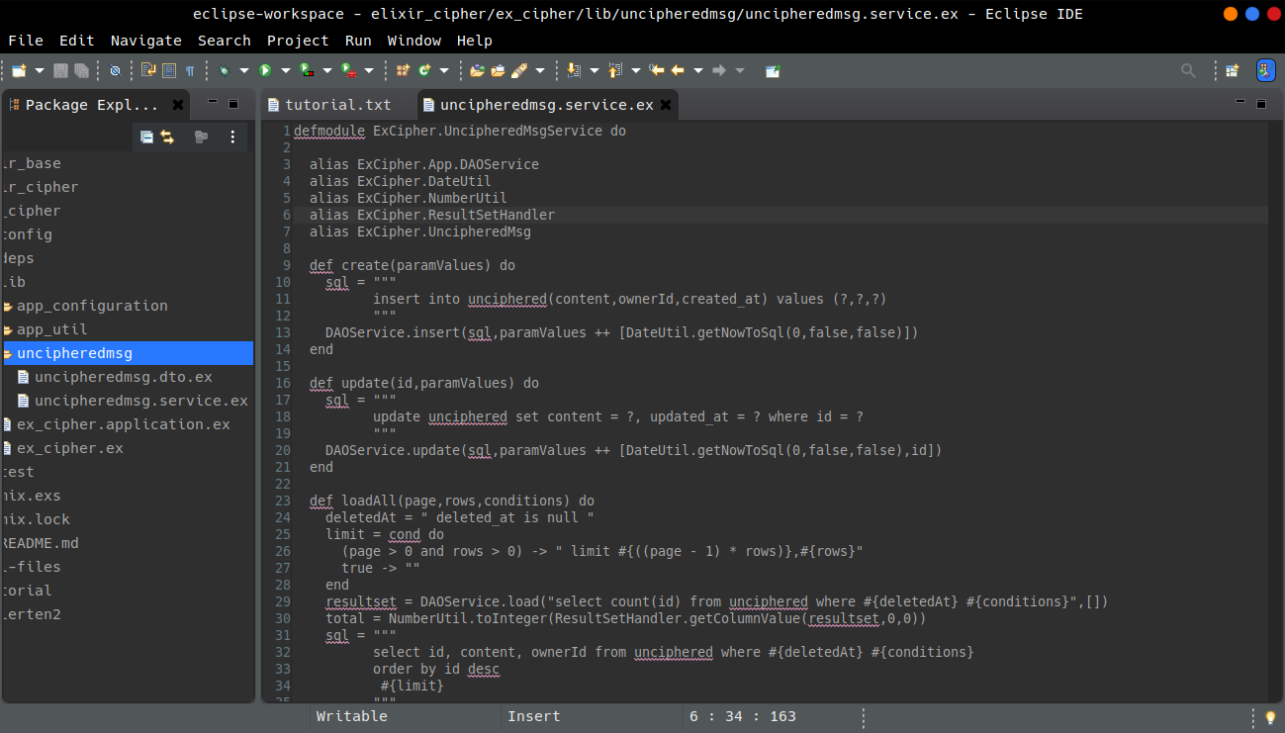

Slide 38
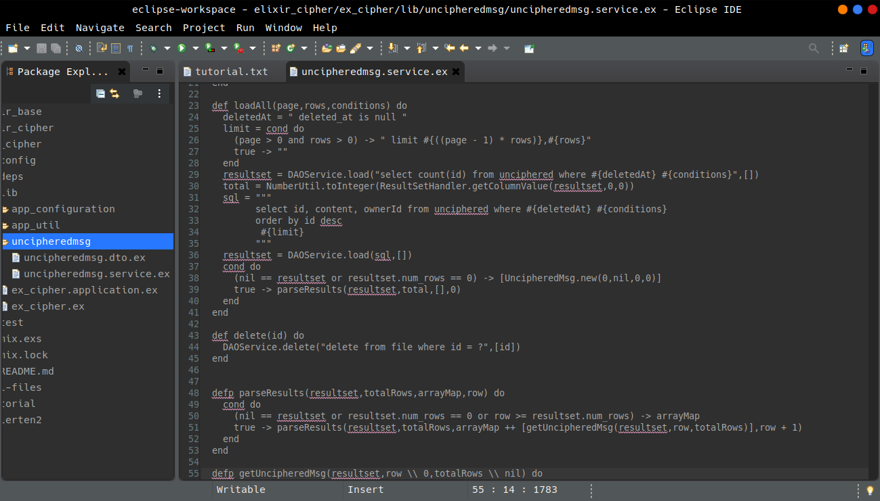

Slide 39
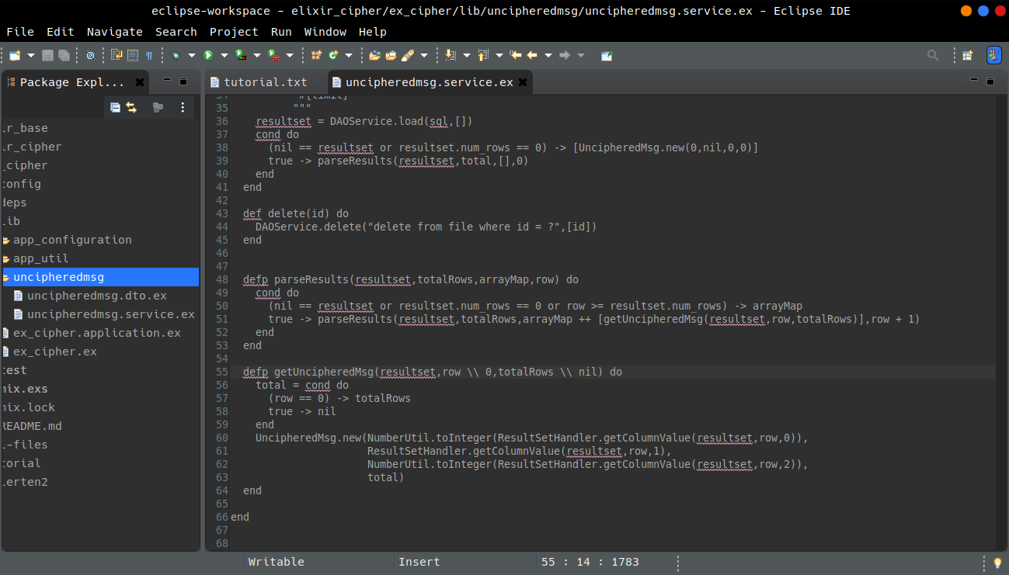

Slide 40
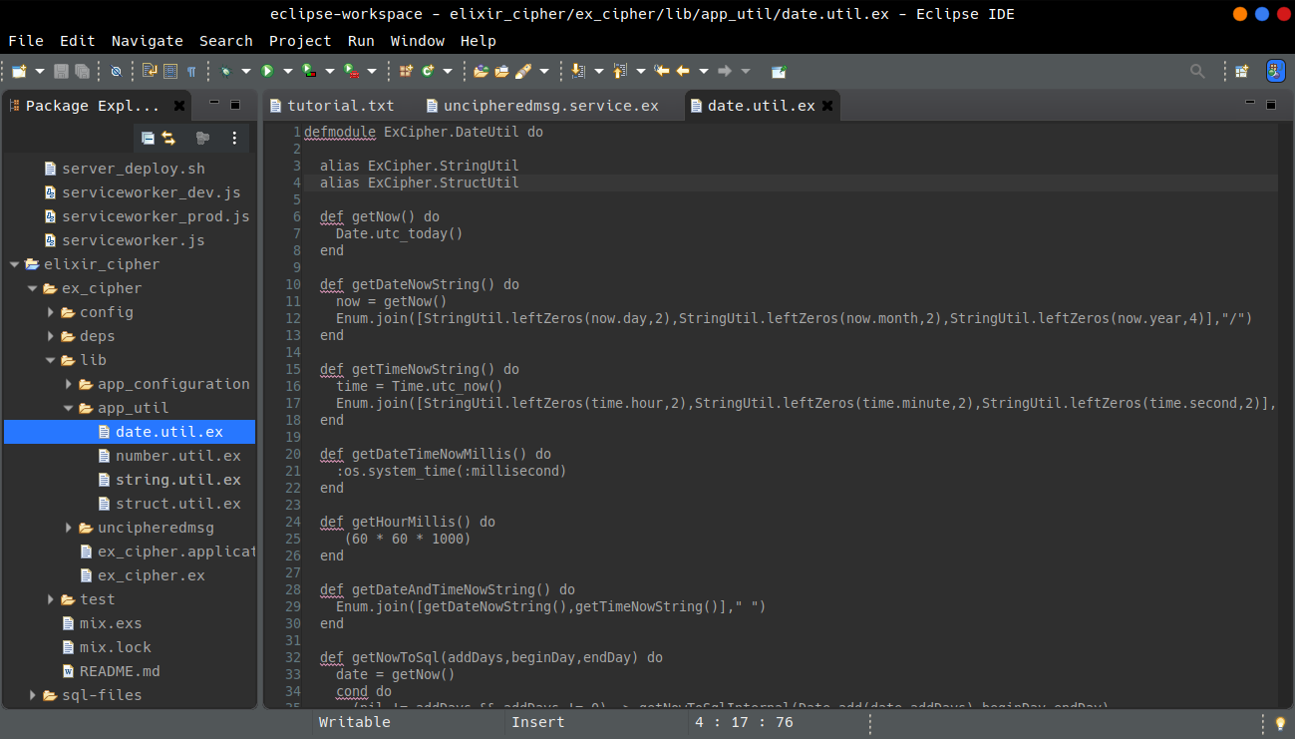

Slide 41
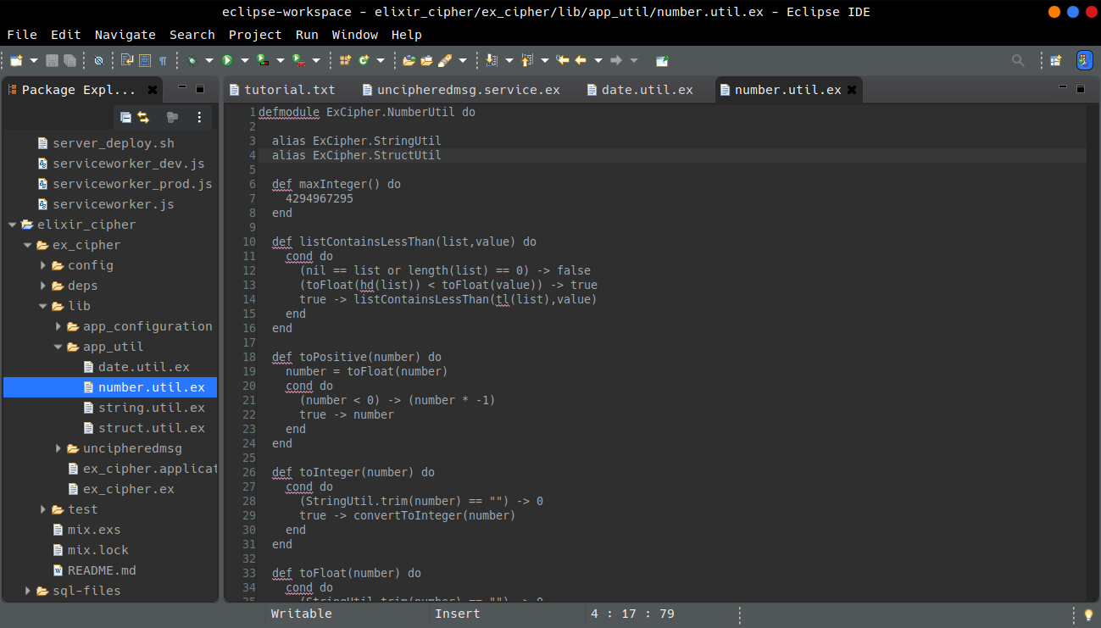

Slide 42
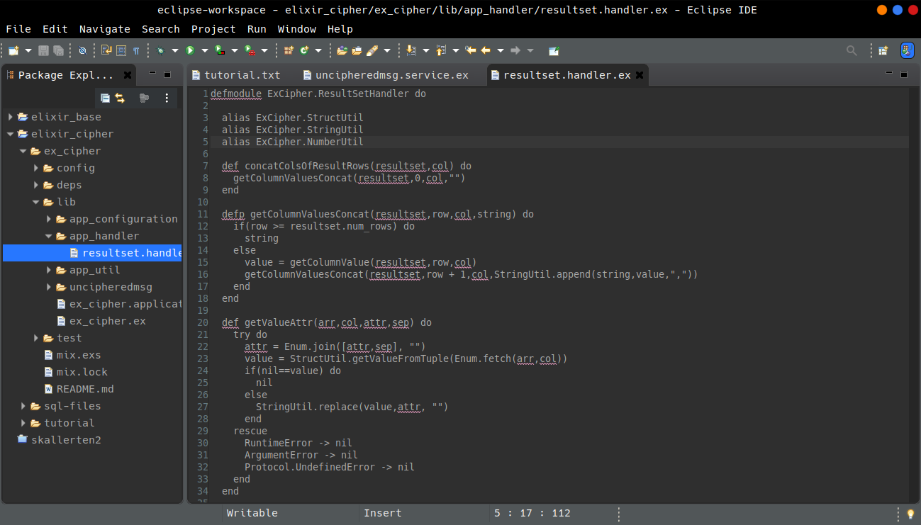

Slide 43
14 - Creating Tasks
Tasks are special modules that are executed concurrently.
cd uncipheredmsg
File >> New >> File [uncipheredmsg.taskstarter.ex]
File >> New >> File [uncipheredmsg.task.ex]
File >> New >> File [uncipheredmsg.writer.ex]
File >> New >> File [uncipheredmsg.reader.ex]

Slide 44
Register the task starter in application initialization.
sudo mix do deps.get, deps.compile, compile
sudo mix run --no-halt
What!? Nothing yet!
Hum we need add the application module to mix.exs file.

Slide 45
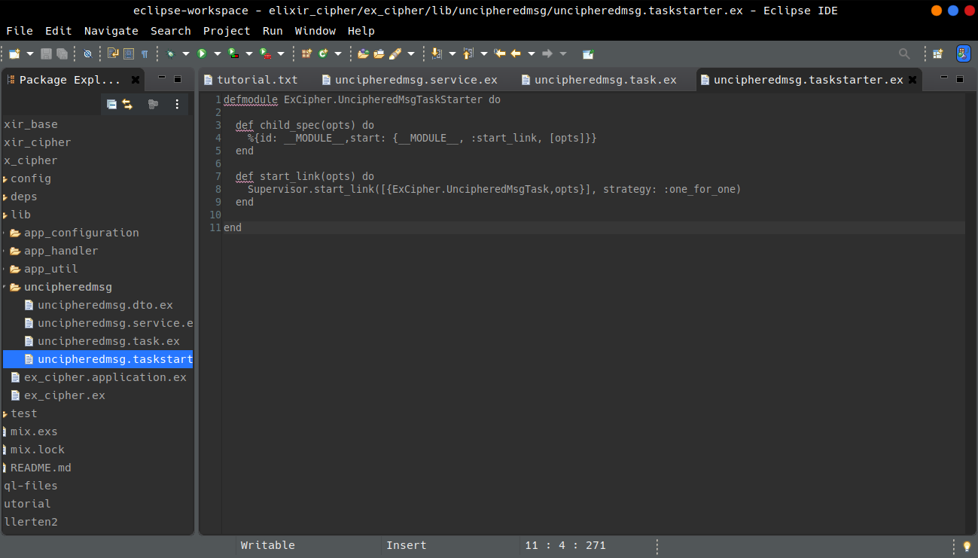

Slide 46
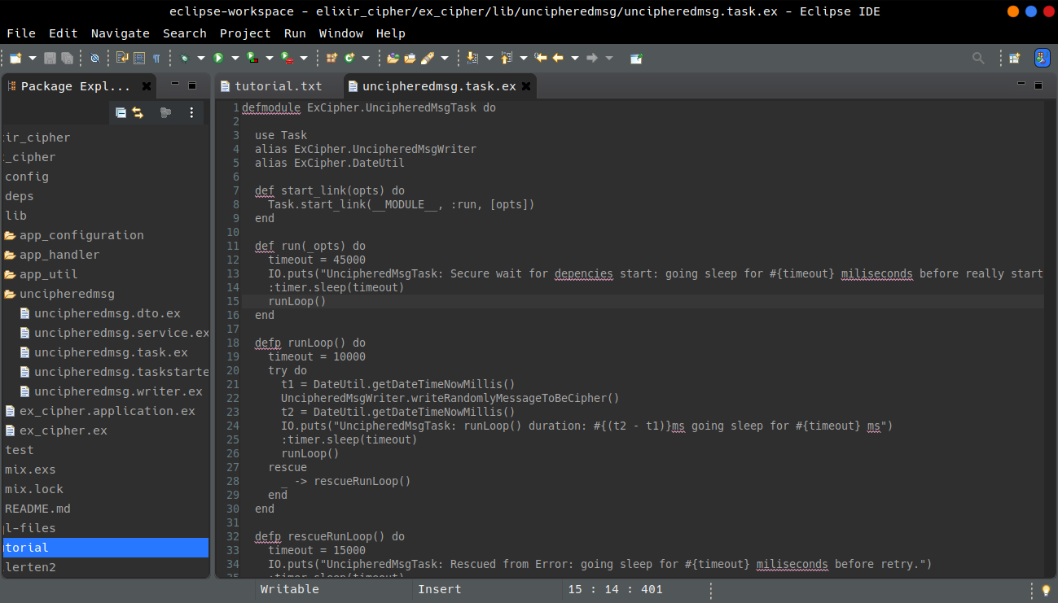

Slide 47
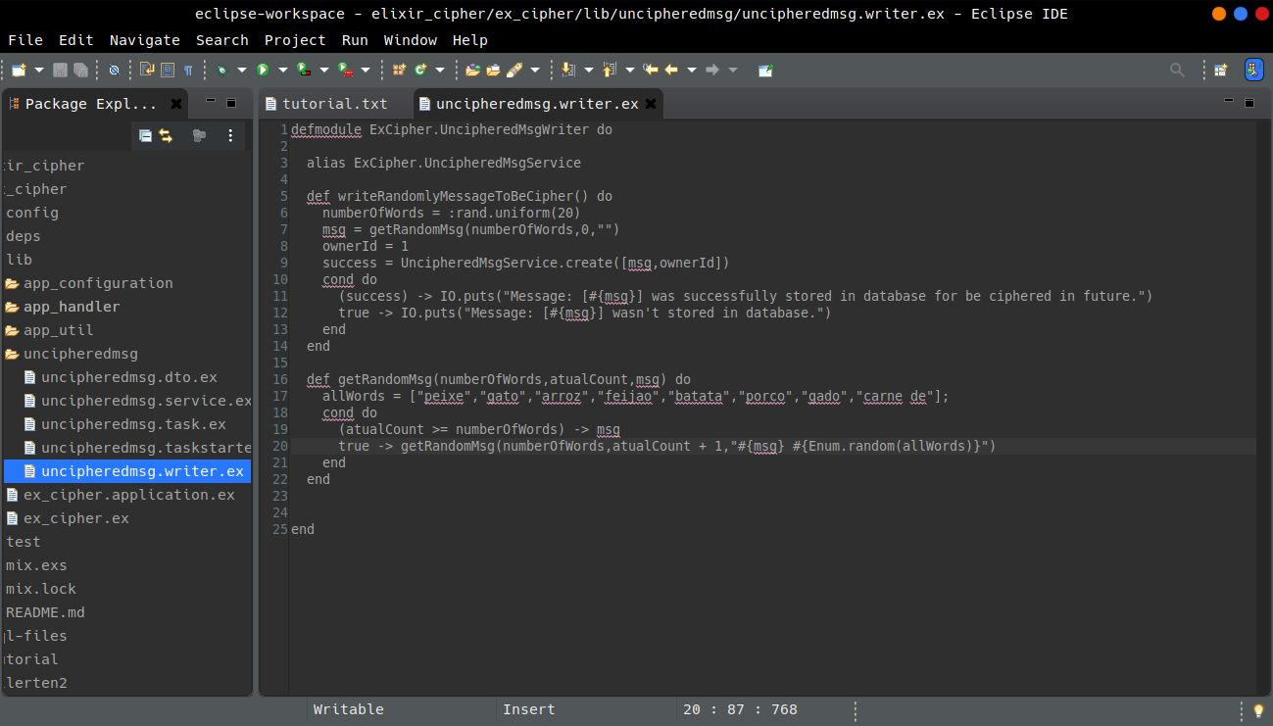

Slide 48
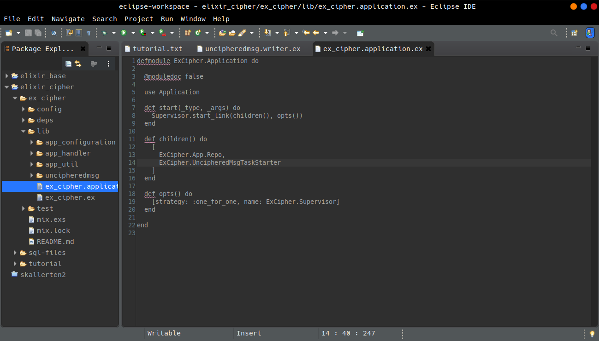

Slide 49
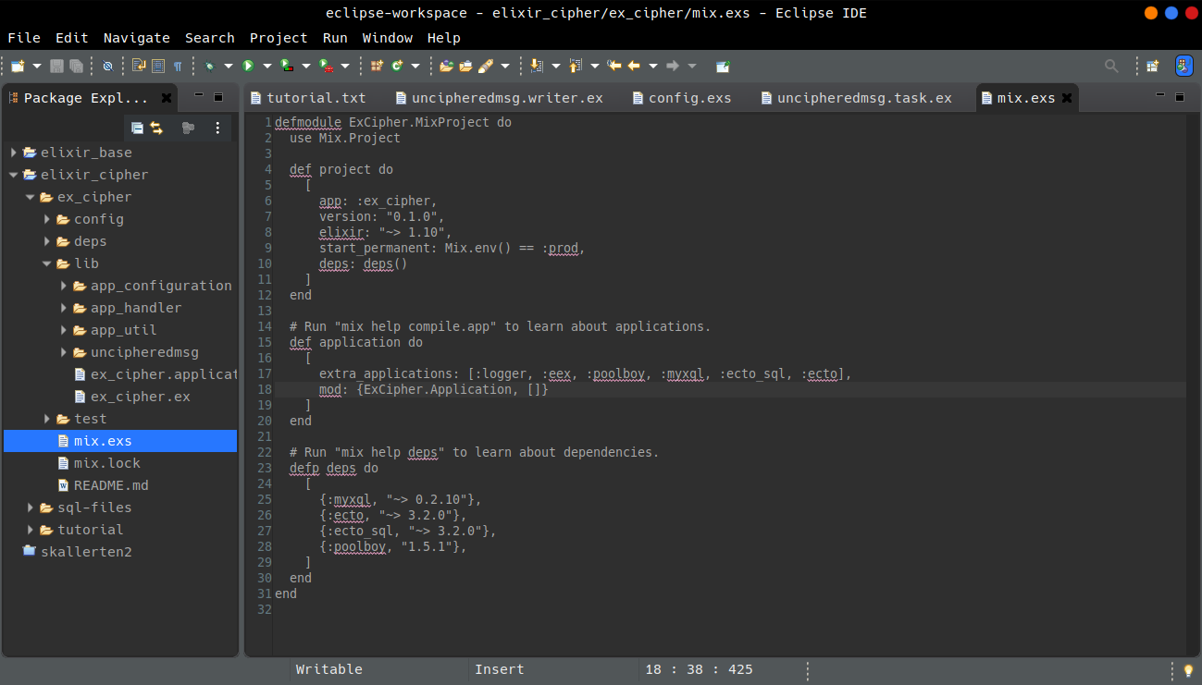

Slide 50
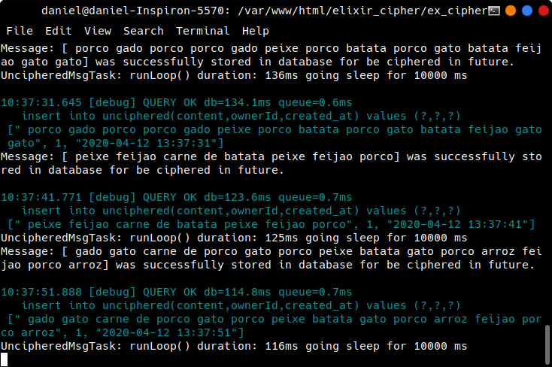

Slide 51
cd ex_cipher/lib
mkdir cipheredmsg
cd cipheredmsg
File >> New >> File [cipheredmsg.dto.ex]
File >> New >> File [cipheredmsg.service.ex]
File >> New >> File [cipheredmsg.taskstarter.ex]
File >> New >> File [cipheredmsg.task.ex]

Slide 52
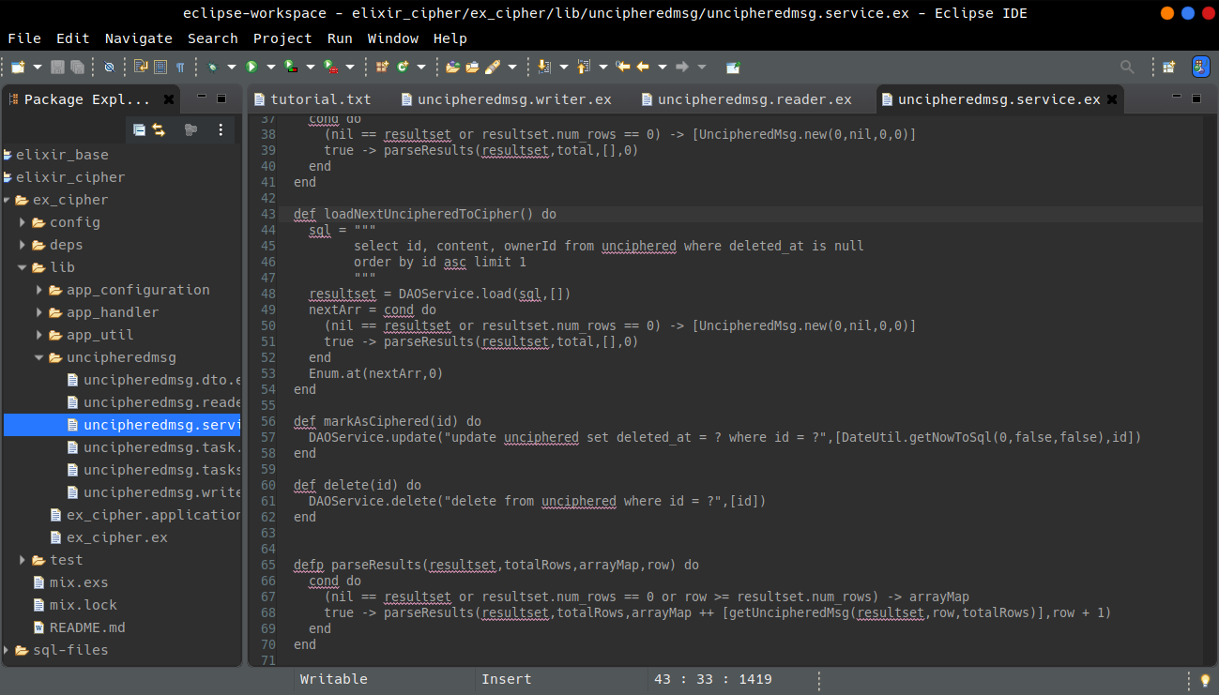

Slide 53
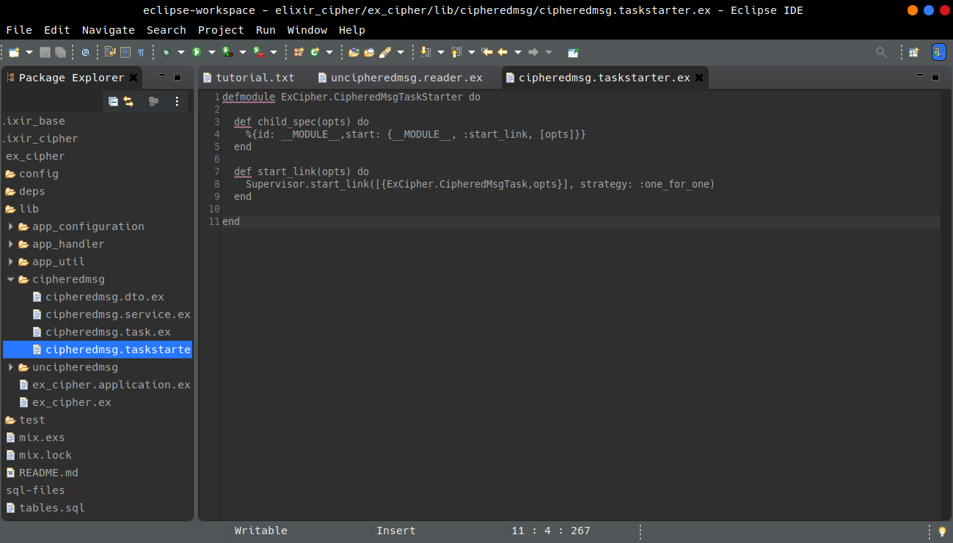

Slide 54
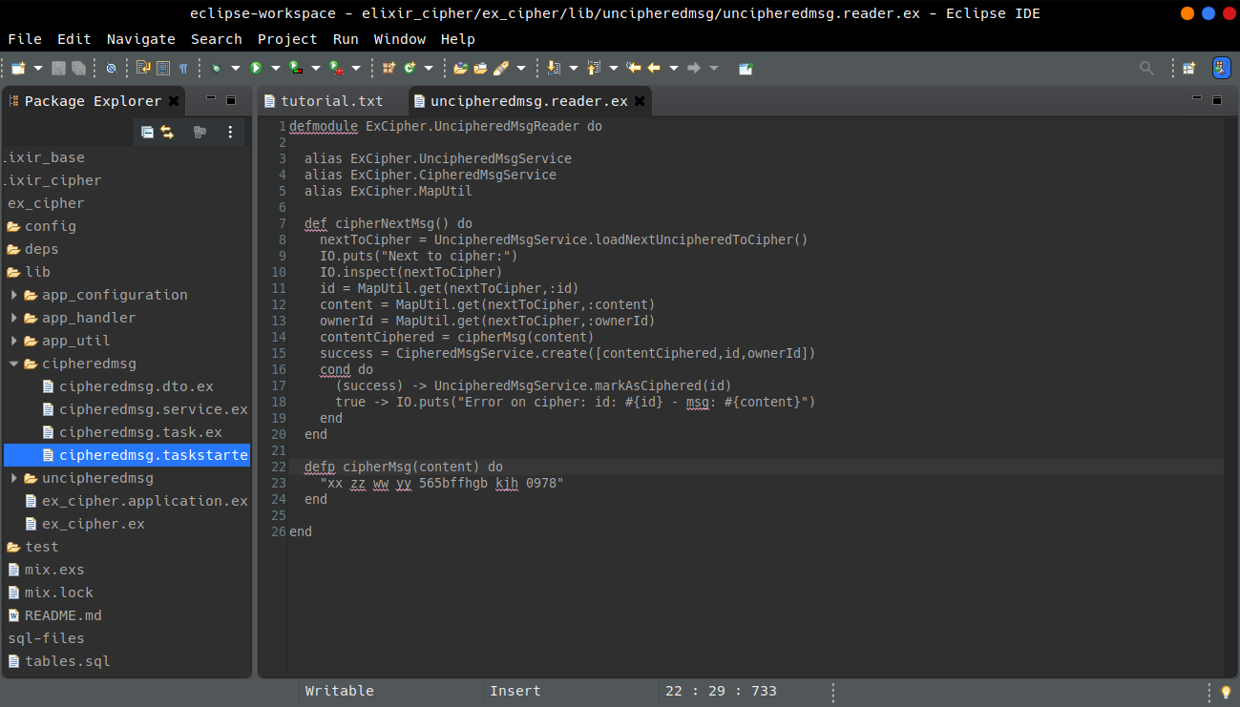

Slide 55
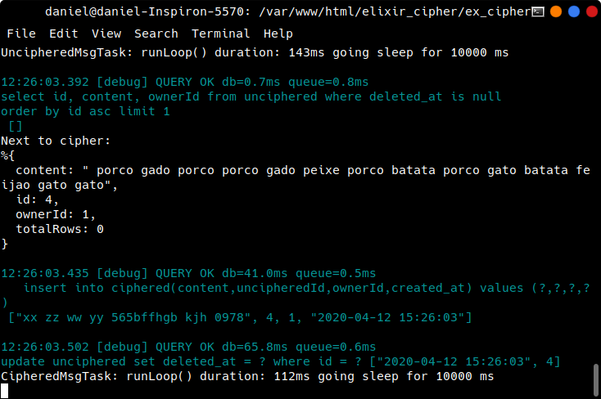

Slide 56
Making listen requests and run as Web Application
15 - Cowboy server lib, Plug lib and Endpoint module
cd ex_cipher/lib
File >> New >> File [ex_cipher.endpoint.ex]

Slide 57
Routes, Plugs, adjust configs

Slide 58
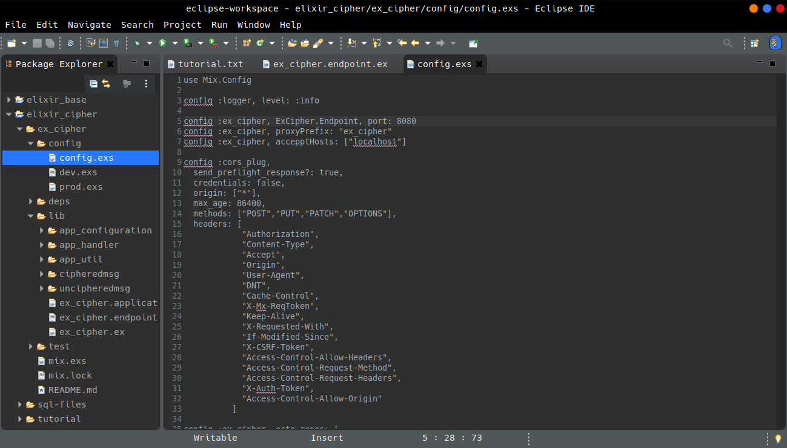

Slide 59
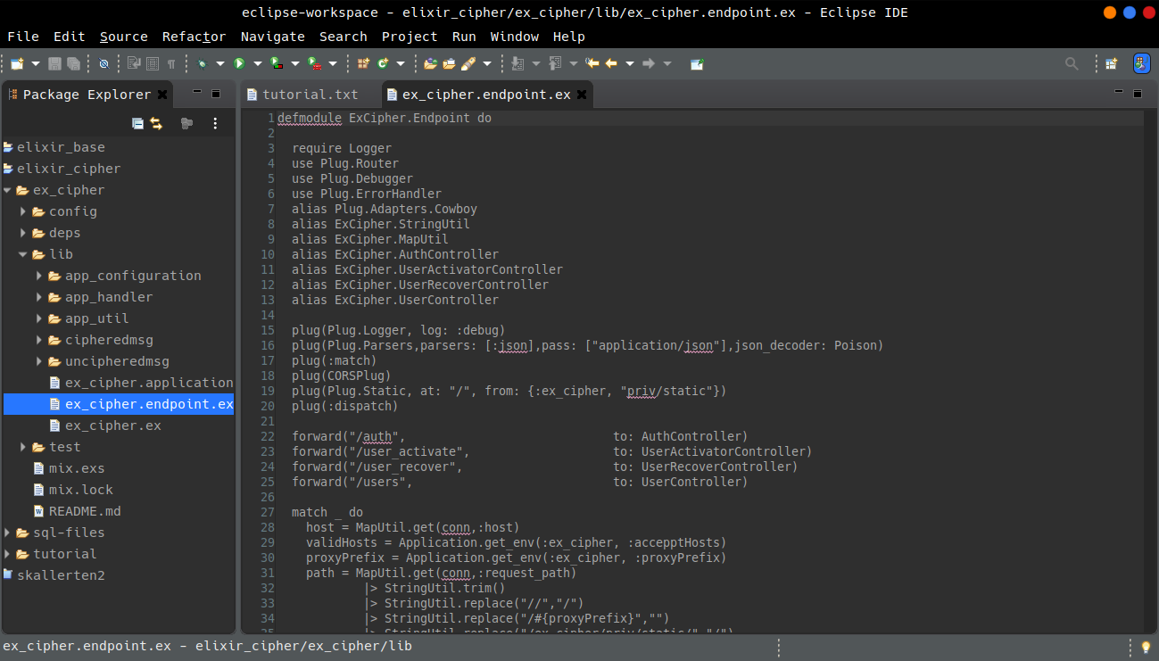

Slide 60
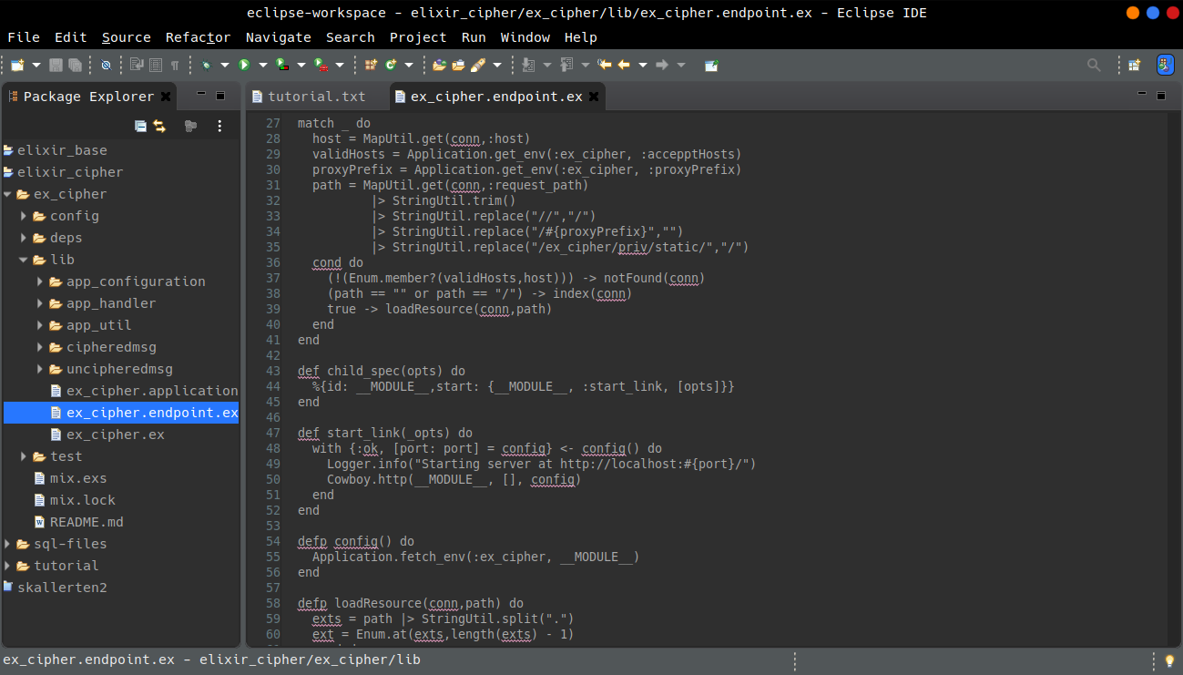

Slide 61
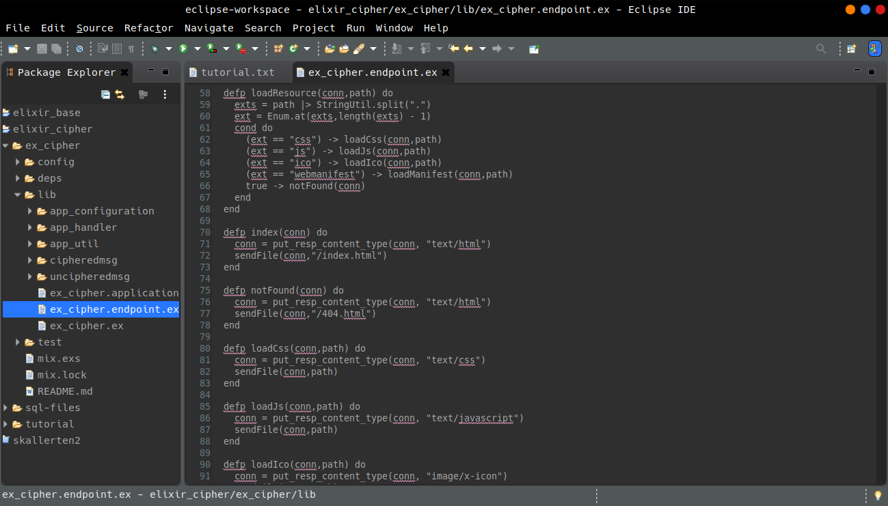

Slide 62
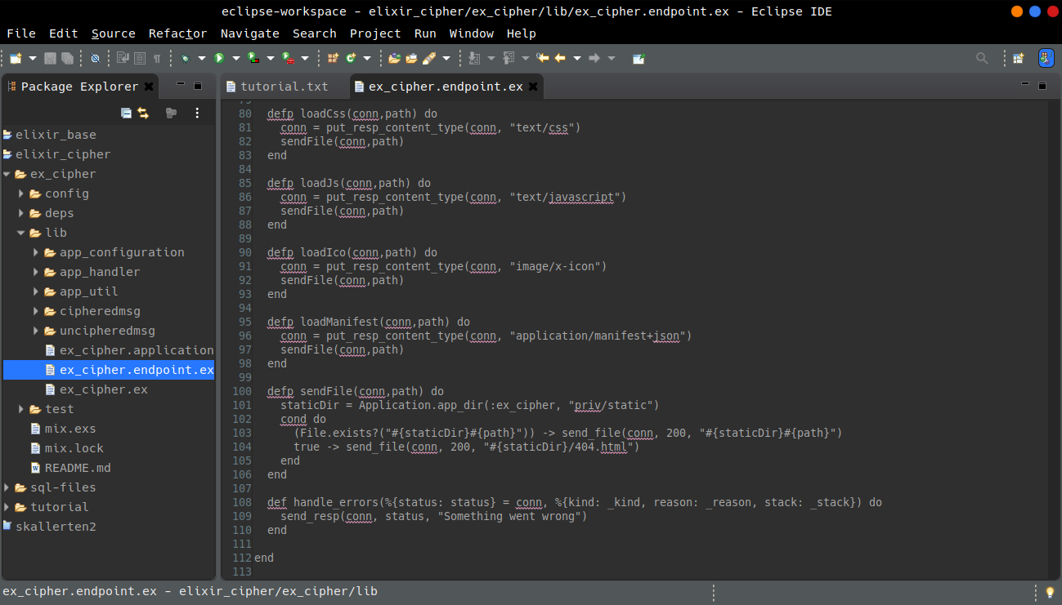

Slide 63
Add libraries to mix.exs

Slide 64
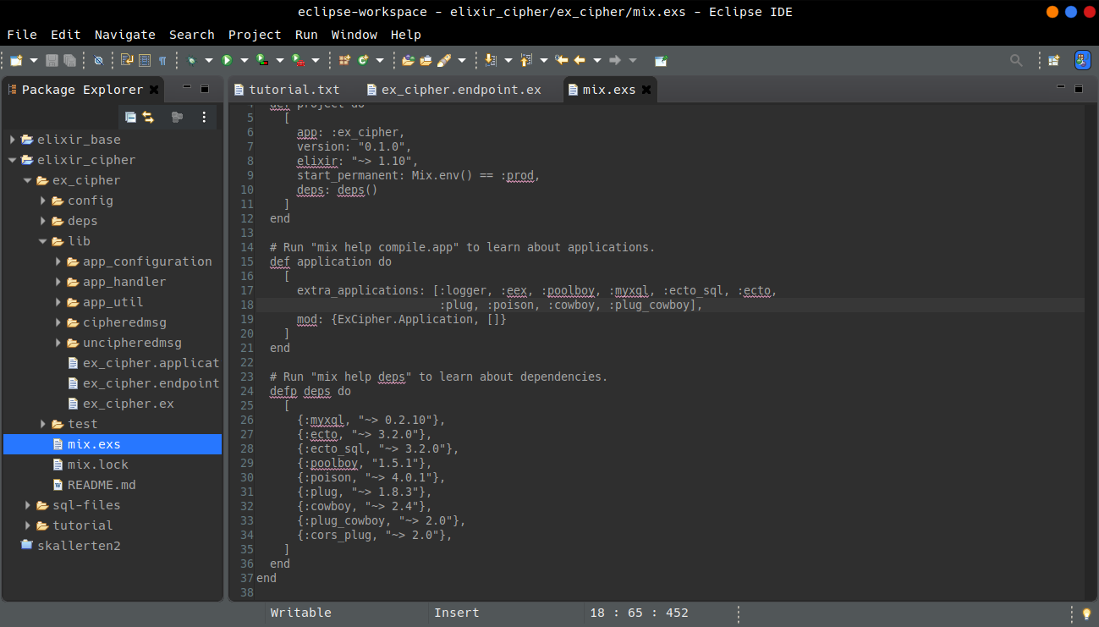

Slide 65
Static Files
16 - Create diretory for static files
cd ex_cipher
mkdir priv
cd priv
mkdir static

Slide 66
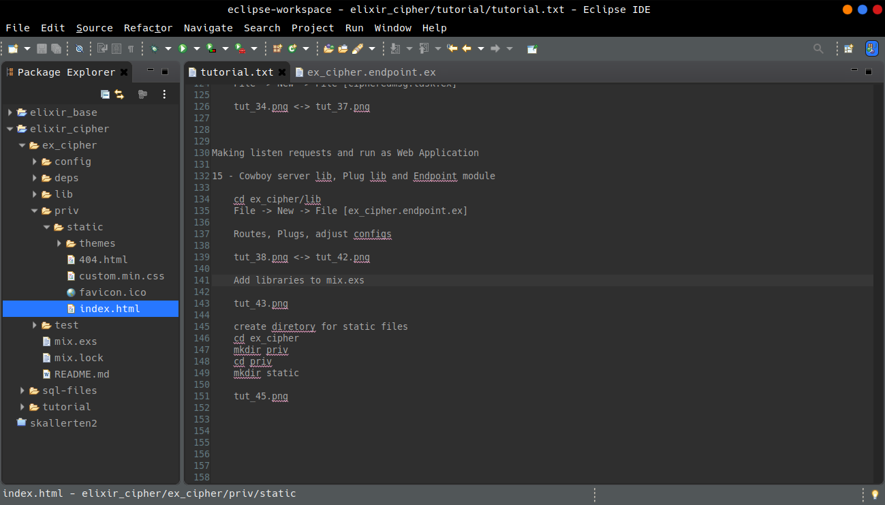

Slide 67
Routing
17 - Create base modules for routes
cd ex_cipher/lib
mkdir app_controller
File >> New >> File [base.controller.ex]
File >> New >> File [basic.controller.ex]

Slide 68
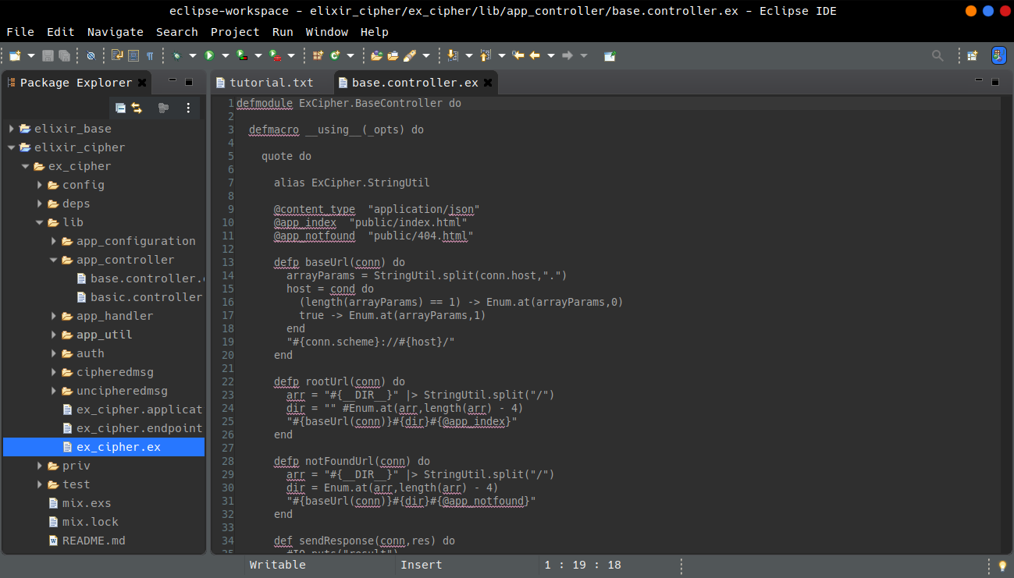

Slide 69
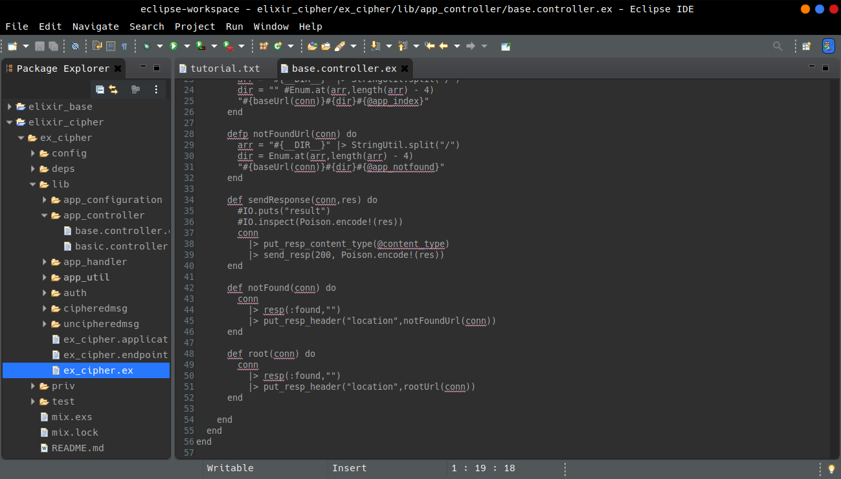

Slide 70
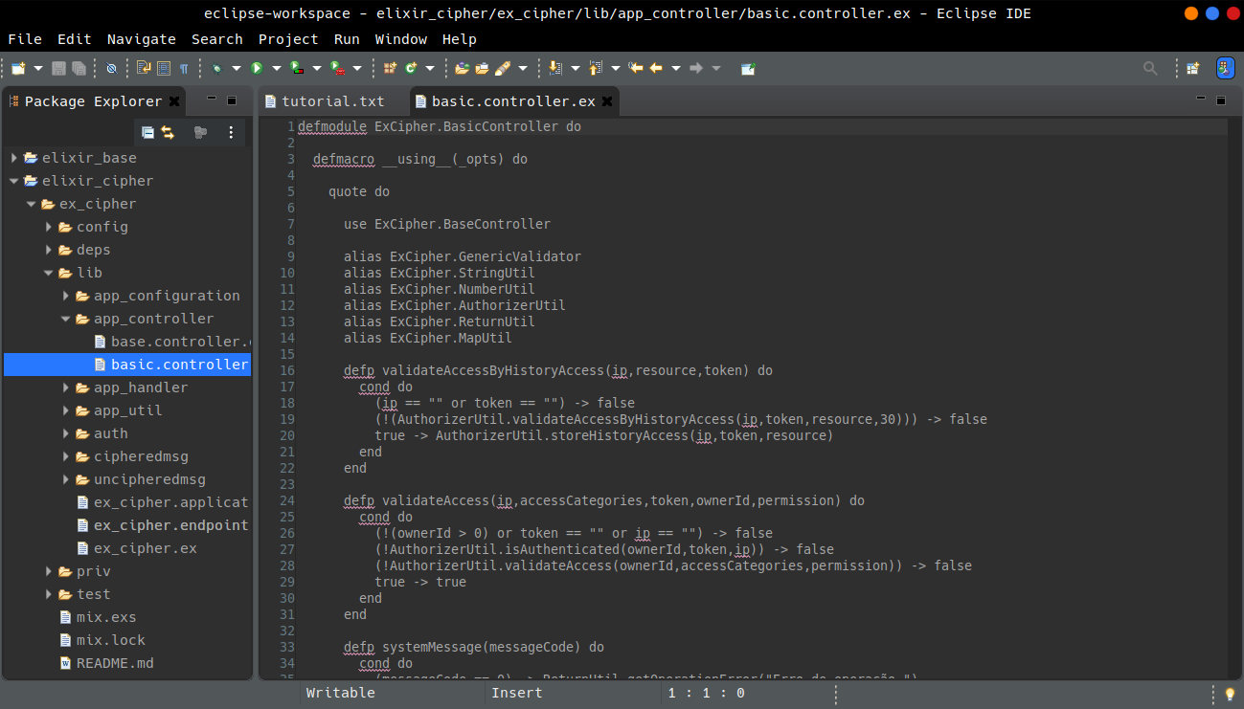

Slide 71
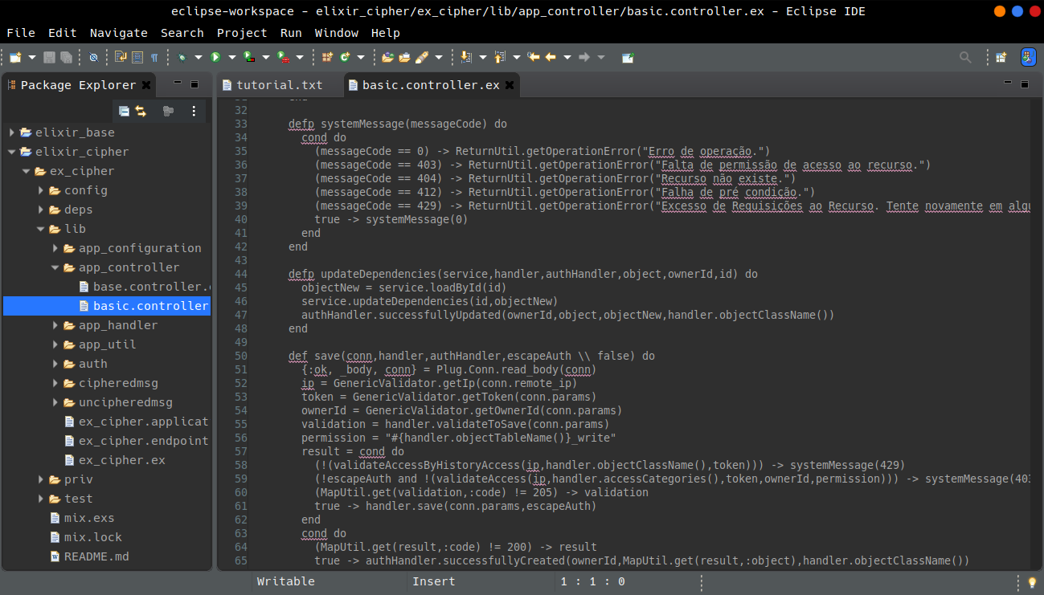

Slide 72
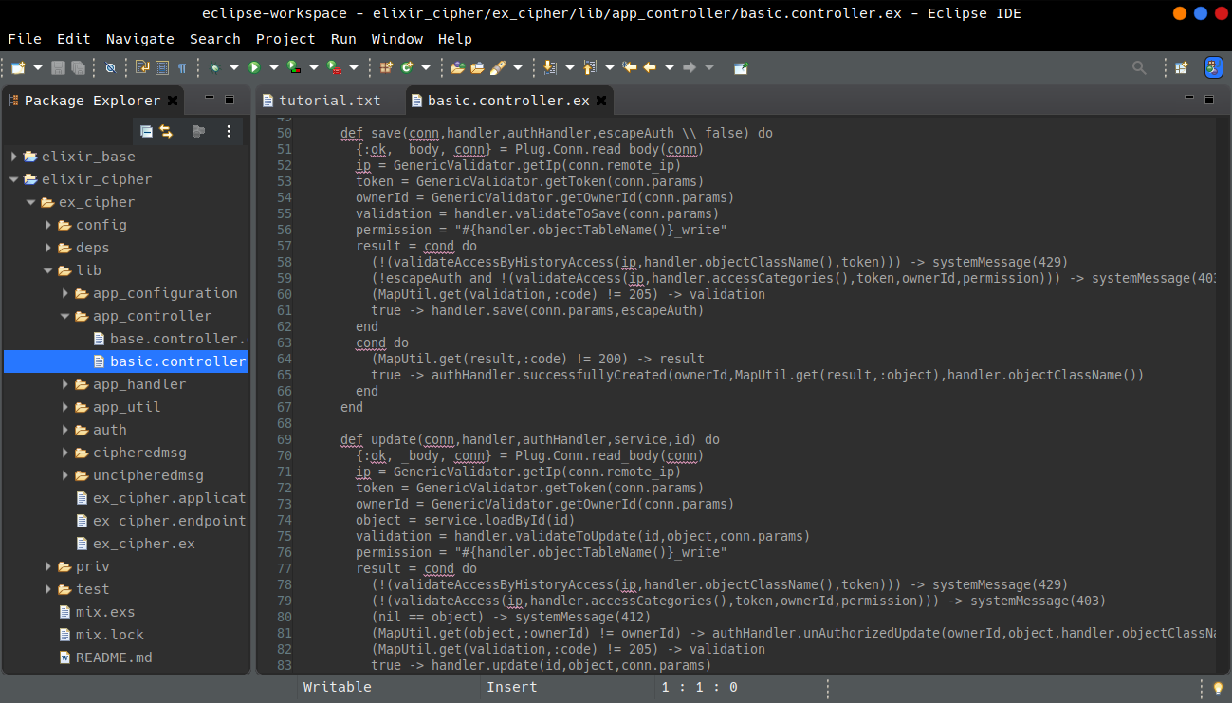

Slide 73
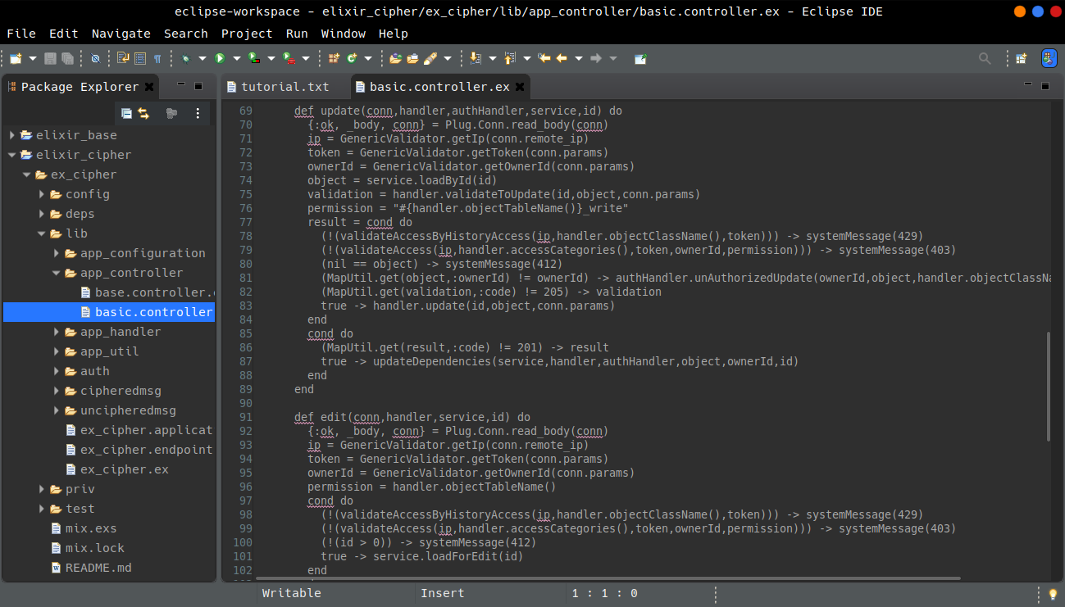

Slide 74
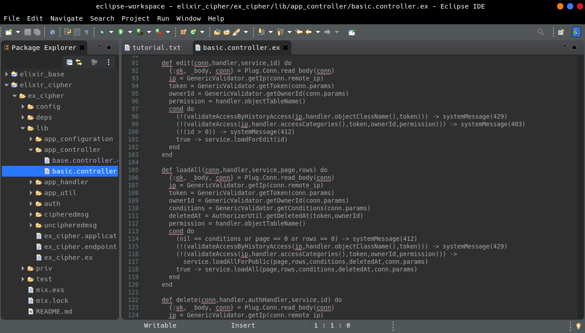

Slide 75


Slide 76
18 - Create auth route functions
cd ex_cipher/lib
mkdir auth
cd auth
File >> New >> File [auth.controller.ex]
File >> New >> File [auth.handler.ex]

Slide 77


Slide 78


Slide 79
19 - Create user route functions
cd ex_cipher/lib | mkdir user | cd user
File >> New >> File [user.controller.ex]
File >> New >> File [user.dto.ex]
File >> New >> File [user.handler.ex]
File >> New >> File [user.service.ex]
File >> New >> File [user.validator.ex]

Slide 80
File >> New >> File [useractivator.controller.ex]
File >> New >> File [useractivator.handler.ex]
File >> New >> File [userrecover.controller.ex]
File >> New >> File [userrecover.handler.ex]

Slide 81


Slide 82


Slide 83


Slide 84


Slide 85


Slide 86


Slide 87


Slide 88


Slide 89


Slide 90


Slide 91


Slide 92


Slide 93


Slide 94


Slide 95


Slide 96


Slide 97


Slide 98
Endpoint Registration
20 - Add the "Endpoint" to supervision tree in "Application"

Slide 99


Slide 100
Let's see how it's now
21 - Testing
sudo mix do deps.get, deps.compile, compile
sudo mix run --no-halt

Slide 101


Slide 102


Slide 103
Hum, ok, works!?
Let's make a simple interface to make some tests:
register as new user, loggin, loggof,
list users, CRUD of user.

Slide 104
Interface for Tests
22 - New Angular 9+ app
cd elixir_cipher
ng new ang-app

Slide 105


Slide 106
Change some configurations of angular.json
and the output url to dir priv/static

Slide 107


Slide 108


Slide 109
cd ang-app
npm install --save @ng-bootstrap/ng-bootstrap
npm install --save ngx-spinner
some copy & paste from another angular project

Slide 110


Slide 111


Slide 112


Slide 113


Slide 114


Slide 115


Slide 116


Slide 117


Slide 118


Slide 119


Slide 120


Slide 121


Slide 122


Slide 123


Slide 124
ng build --prod

Slide 125


Slide 126


Slide 127
ng add @angular/localize
ng build --prod

Slide 128


Slide 129


Slide 130


Slide 131


Slide 132


Slide 133


Slide 134
Hum ... repo not was initialized ...

Slide 135


Slide 136
Well let's add to 'Application' ... Now works!

Slide 137


Slide 138


Slide 139


Slide 140


Slide 141


Slide 142


Slide 143


Slide 144


Slide 145


Slide 146


Slide 147


Slide 148


Slide 149


Slide 150
Putting in production
Can be a external server running for tests in production or the production server. The method is same.

Slide 151
23 - Making a build
sudo mix do deps.get, deps.compile, compile
sudo mix release.init

Slide 152
You will see new "rel" folder whit 3 files. Let's edit "vm.args.eex" to
tunning the app for use less % of CPU. This is important for burstable CPU
servers as AWS EC2 for example. After this don't execute
"sudo mix release.init" command, otherwise the config will lost and
you'll need redo this.
+sbwt none
+sbwtdcpu none
+sbwtdio none

Slide 153


Slide 154
sudo MIX_ENV=prod mix release
Note the new "prod/rel/ex_cipher" folder under "_build".
This is "The compilation"

Slide 155


Slide 156


Slide 157


Slide 158
24 - Preparing deploy: scripts to create
Because I use /var/www/html folder to develop projects
my deploy target will /var/www/elixir
cd /var/www | sudo mkdir elixir
Create a new file "make_files.sh"
Add a execution permission:
sudo chmod +x make_files.sh
Edit as follow.

Slide 159


Slide 160


Slide 161


Slide 162
Run the created script to generate some files that will used in next steps.
sudo ./make_files.sh dev ("dev" or "prod" as arg[0] parameter)

Slide 163


Slide 164
Now let's see some "magic", making the build and moving the
"compilated" files to application work dir (/var/www/elixir).
sudo ./make_release.sh

Slide 165
Put the "builded" code to run, and configure the application to
auto start as machine daemon process:
cd /var/www/elixir/elixir_cipher
sudo ./elixir_cipher_init.sh

Slide 166


Slide 167
Verify if started as process:
sudo systemctl status elixir_cipher
Loaded as service? OK
Activation: Failed.
The message say that something was wrong on initialization.

Slide 168


Slide 169


Slide 170


Slide 171
Ok. Finded the problem.
Ctrl + C, Ctrl + V was fail on creating the file "make_files.sh",
the module name should be "ExCipher" but was "ExApp".

Slide 172


Slide 173
Stop process and remove:
sudo systemctl stop elixir_cipher
sudo systemctl disable elixir_cipher

Slide 174
Now Repeat All processes:
cd /var/www/html/elixir_cipher/ex_cipher
sudo ./make_files.sh
sudo ./make_release.sh
cd /var/www/elixir/elixir_cipher
sudo ./elixir_cipher_init.sh
sudo systemctl status elixir_cipher
Yes! All Works: Web Server, DB Repo processes, Concurrent Tasks.

Slide 175


Slide 176


Slide 177


Slide 178
What can be bettered?
25 - Create and adapt yourself scripts to deploy.
26 - Static files should be stored in a CDN ( S3 / CloudFront, etc).
27 - Item 25 involves 26 case you move angular files to cloud.
28 - Don't expose Cowboy Server. Make Port 8080 (or other)
not publicly accessible.
Use a reverse proxy to handle external requests: An Apache,
or Ngnix or other. Probably whit it you will need change some
urls in angular app and in the endpoint.

Slide 179
29 - Use one Database machine (RDS instance) for each Ecto Repo,
for better performance/scalability.
30 - Make DB accessible only by IPs of your server.
31 - Use HTTPS. Redirect all HTTP requests to HTTPS.
Let's Encrypt works fine for free: https://letsencrypt.org/pt-br/ .

Slide 180
Real Life Use Case: skallerten.com.br

Slide 181


Slide 182


Slide 183


Slide 184


Slide 185


Slide 186


Slide 187


Slide 188


Slide 189


